Slide 1
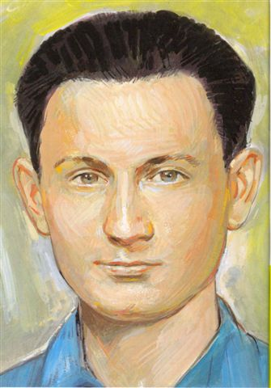
Feast of Blessed István Sándor

Slide 2
Where was István Sándor born?
 | B) Szolnok, Hungary
A) Makati city, Philippines | B) Szolnok, Hungary
C) Péliföldszentkereszt, Hungary | D) Bucarest, Romania
1
point
1

Slide 3
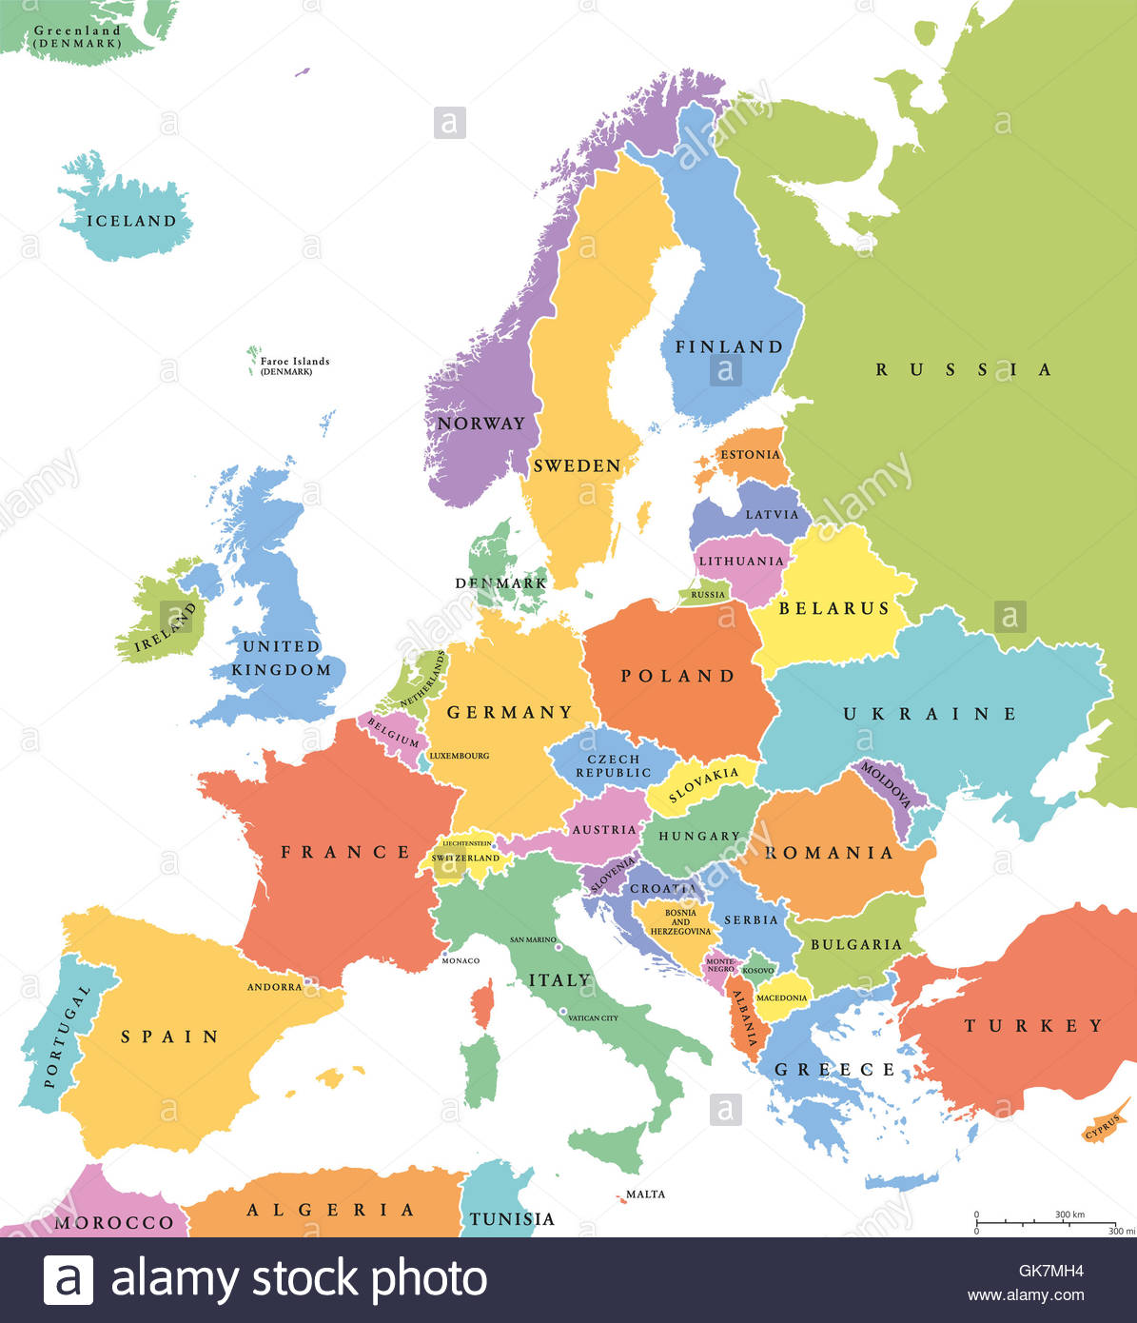

Slide 4
As a child, he frequented the parish of the…
A) Franciscans | B) Salesians
C) Carmelites | D) Diocese
A) Franciscans
2
points
2

Slide 5
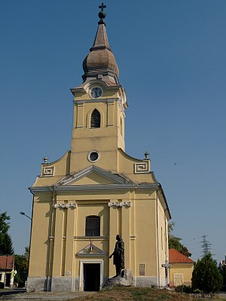

Slide 6
In his childhood, he suffered an accident, of which he wore the mark until the end of his life. What was this accident?
 | D) A horse gave him a kick.
A) He fell off a tree. | B) Boiling water was poured on his head.
C) A boy broke his nose with a stick. | D) A horse gave him a kick.
2
points
3

Slide 7
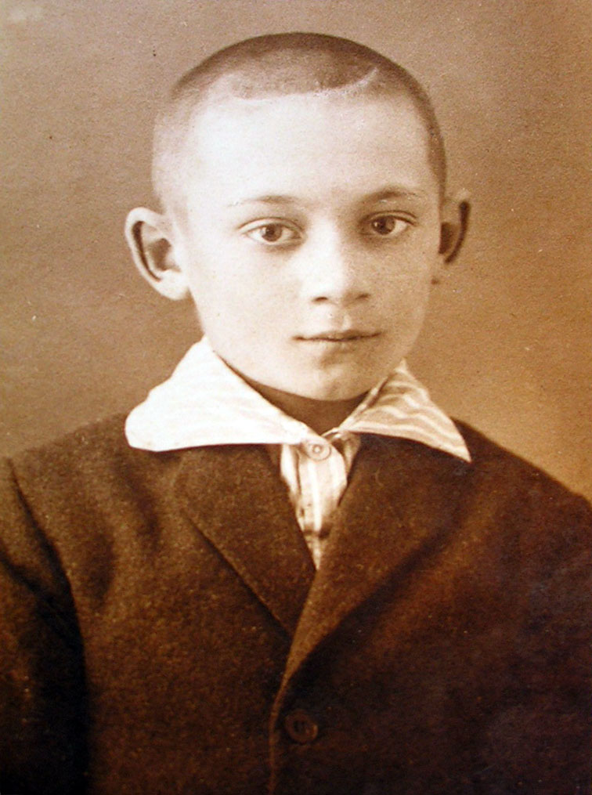

Slide 8
He got to know about Don Bosco through the Salesian Bulletin.
A) True.
A) True. | B) False.
C) Maybe. | D) None of these.
1
point
4

Slide 9
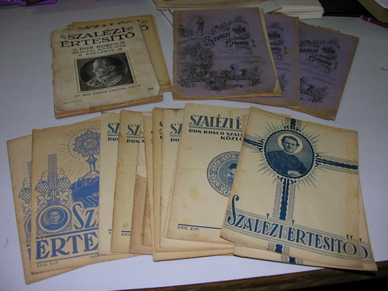

Slide 10
He became an aspirant for the Salesian life only at the age of 21. Why?
 | D) His father did not give his consent.
A) He had a late conversion. | B) He was reflecting a lot before the decision.
C) He got to know the Salesians at that age. | D) His father did not give his consent.
2
points
5

Slide 11
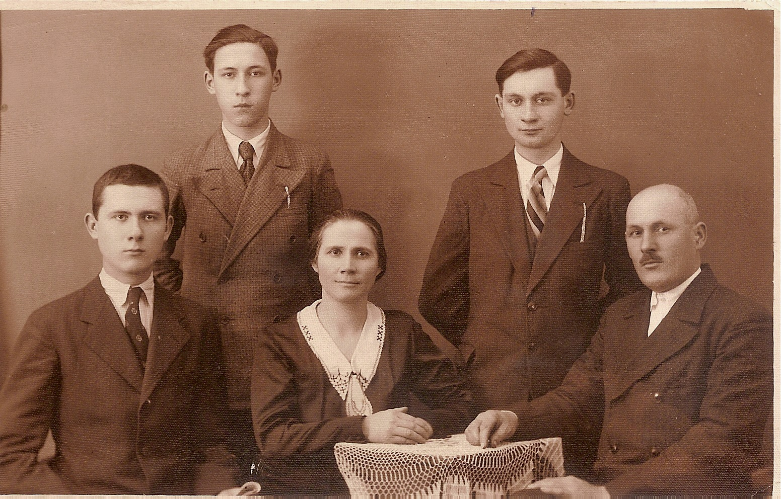

Slide 12
He received a medal of honor during World War II. Why?
 | B) For his good work as a telegraph operator.
A) For saving a soldier's life. | B) For his good work as a telegraph operator.
C) For obeying his commanders even in times of difficulties. | D) For serving the army more than 3 years.
2
points
6

Slide 13
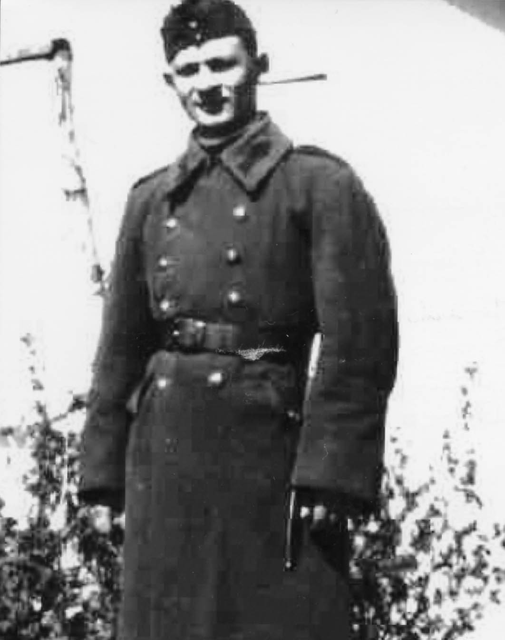

Slide 14
What did he miss the most during his military service?
C) The Eucharist.
A) The confreres. | B) The cakes of his mother.
C) The Eucharist. | D) His own room.
1
point
7

Slide 16
In which profession did he receive a 'Masters’ Degree'?
A) Printer.
A) Printer. | B) Farmer.
C) Doctor. | D) Tailor.
1
point
8

Slide 17
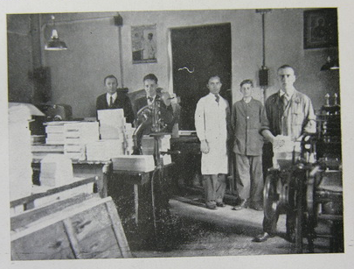
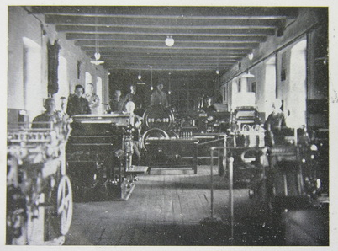

Slide 18
What was NOT part of his apostolate?
 | B) Teaching in secondary school.
A) Serving as sacristan. | B) Teaching in secondary school.
C) Forming altar servers. | D) Assistance in dormitory.
1
point
9

Slide 19
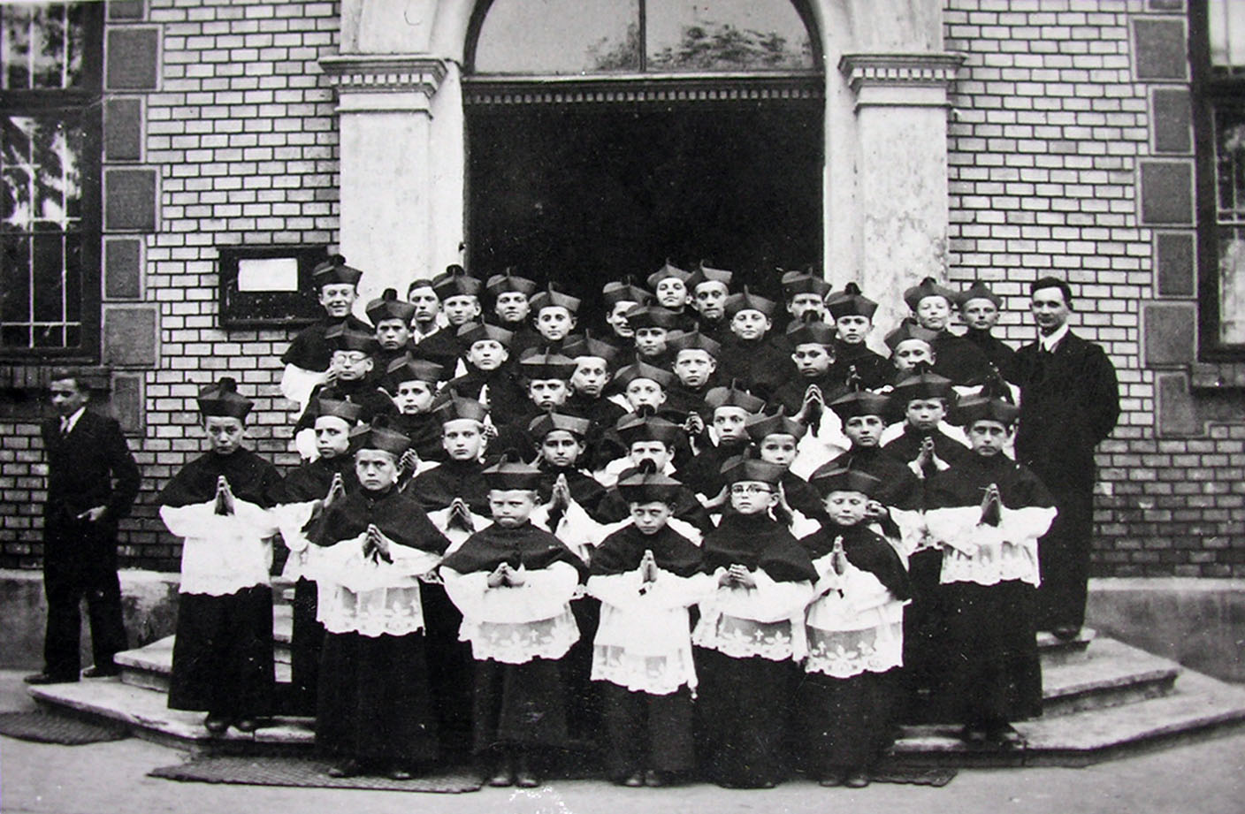
Notes:
Encircle Sandor…

Slide 20
He received a passport with his false name to escape. Why did he not leave the country?
 | B) He decided to stay with his boys.
A) He had no courage. | B) He decided to stay with his boys.
C) He was caught at the border. | D) His superiors did not allow him.
1
point
10

Slide 21
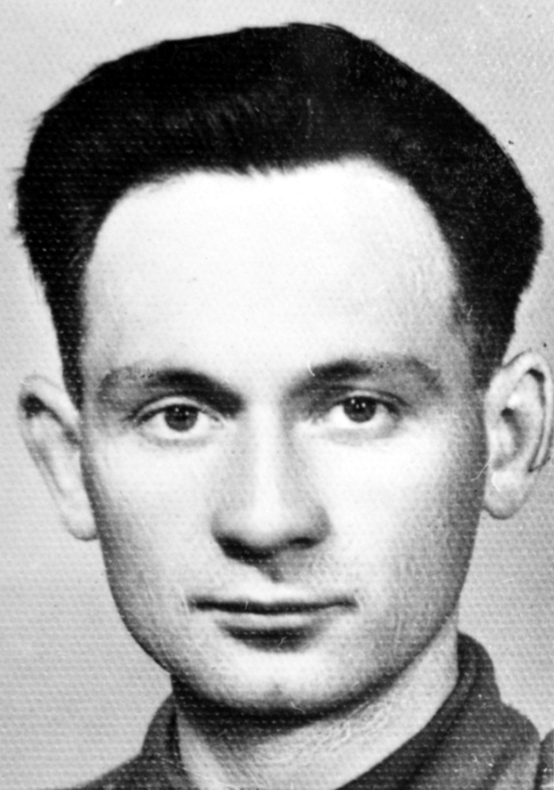
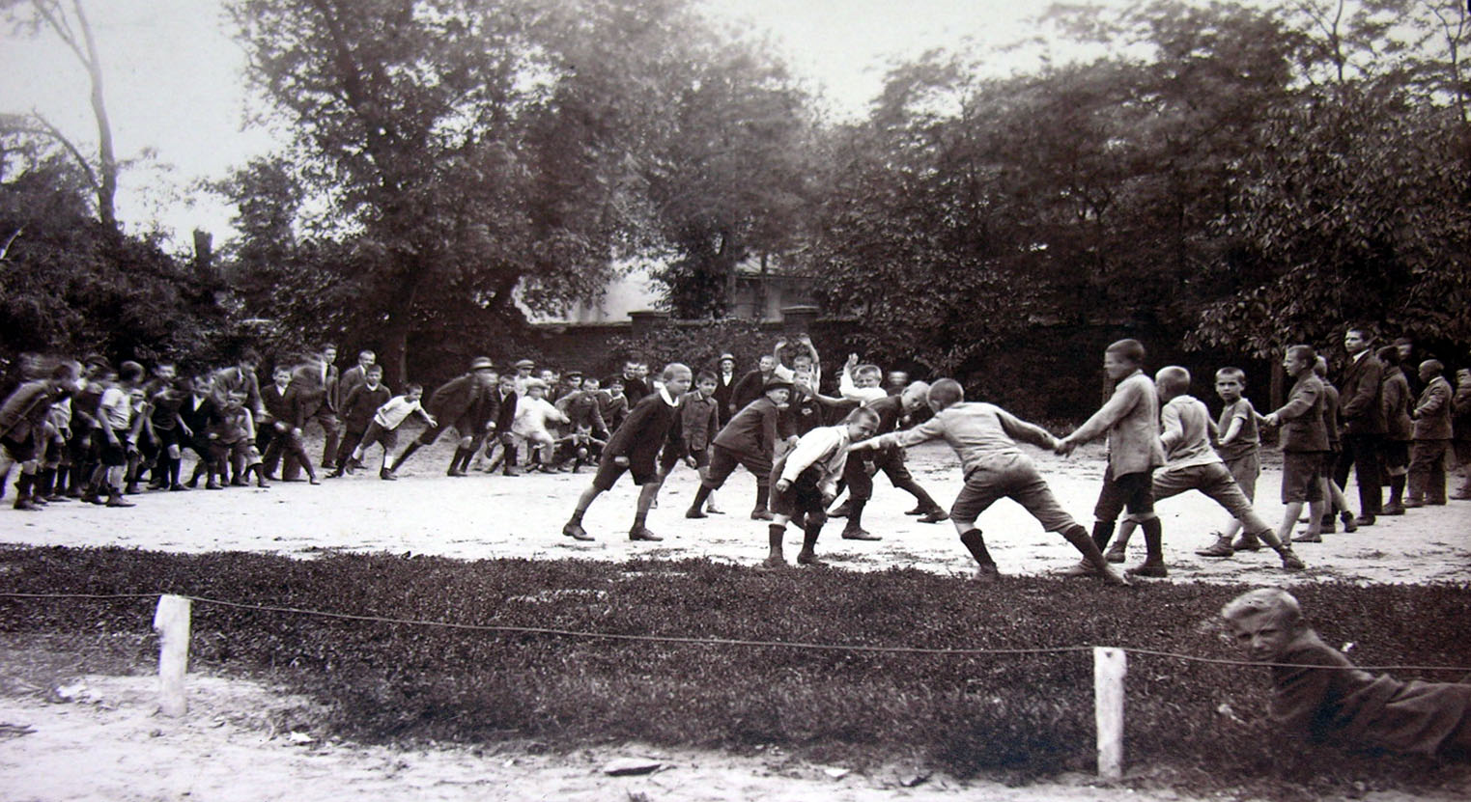

Slide 22
His boys were scandalized by the name of a new bar in the neighborhood. They put black paint on its "name board". What was this scandalizing name?
C) Hell Bar. Enter the hell!
A) The Antichrist is near | B) If you want to see God, come and drink!
C) Hell Bar. Enter the hell! | D) Anti-Christian bar
2
points
11

Slide 23
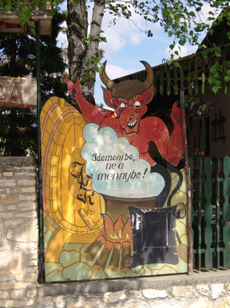

Slide 24
What was he accused of that led to his execution?
A) Stealing governmental documents. | B) Conspiracy against the state.
C) Trying to escape abroad illegally. | D) There was no official accuse.
 | B) Conspiracy against the state.
2
points
12

Slide 25
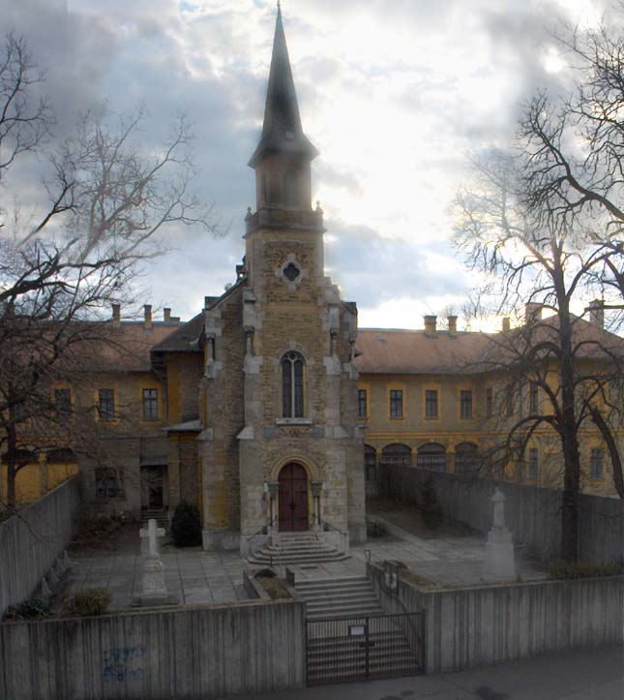

Slide 26
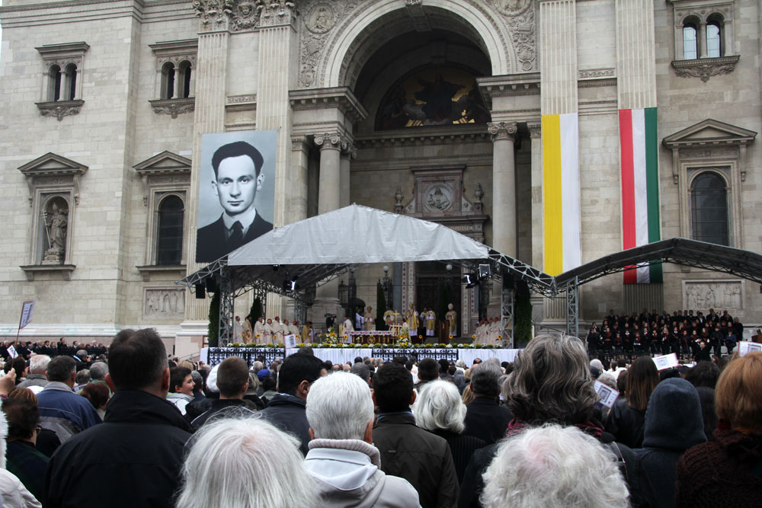

Slide 27
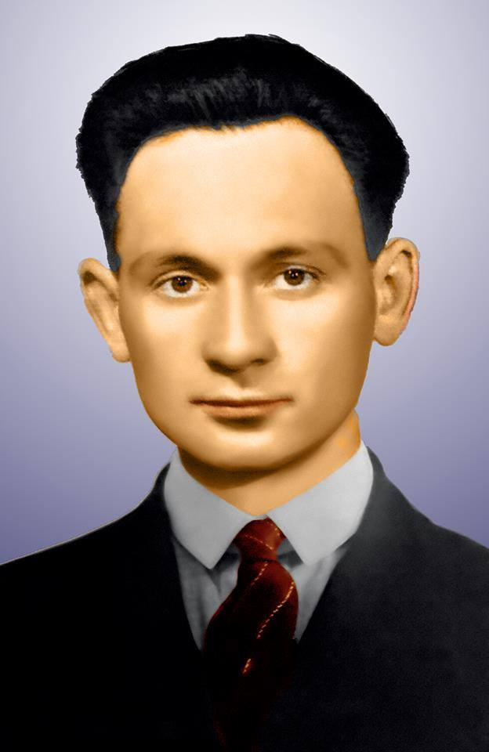
EXTRA QUESTIONS

Slide 28
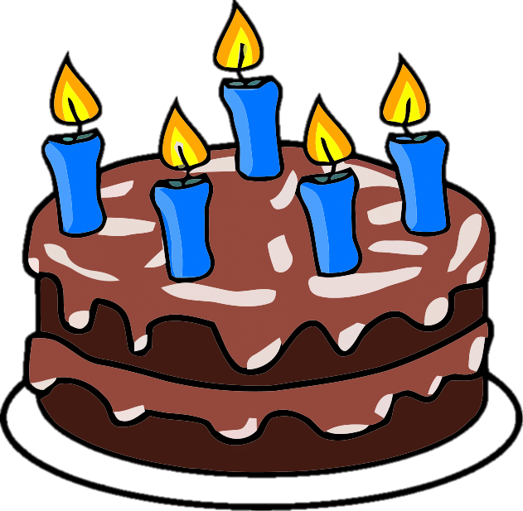
Today is the nth birthday of Bl. István Sándor. (October 26, 2018)
+1
Notes:
104th birthday

Slide 29
Today is the 104th birthday of Bl. István Sándor. (October 26, 2018)
+1
Notes:
104th birthday

Slide 30
He saved the life of somebody who had had an accident.
C) Somebody wanted to get on the moving train but fell off under the wheels.
A) In a robbery, a man was stabbed with a knife. | B) One car hit the wall and the driver was bleeding heavily.
C) Somebody wanted to get on the moving tram but fell off under the wheels. | D) A drunk man riding the bicycle fell off a bridge.
+2

Slide 31
After the dissolution of the religious orders, he had to change his last name with false documents. What was this 'new' family name?
A) Kiss (= Small) | B) Orbán
C) Sanico | D) Szabó (= Tailor)
A) Kiss (= Small)
+3

Slide 32
How many DAYS did Blessed István Sándor live?
+4
Notes:
October 26, 1914 – June 8, 1953 → 14 105 days

Slide 33
How many DAYS did Blessed István Sándor live?
14 105 days
+4
Notes:
October 26, 1914 – June 8, 1953 → 14 105 days

Slide 34
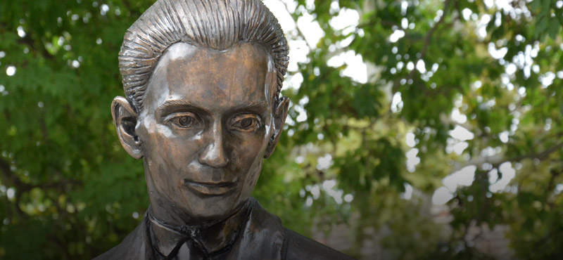
Feast of Blessed István Sándor

